Slide 1
Dependability Analysis of the Apache Commons Daemon Project
Software Dependability Project
Gianluca Ronga

Slide 2

Table of Contents
Project Context
Goal of the Apache Commons Daemon Project
SonarCloud Analysis
Docker Implementation
JaCoCo Code Coverage
Pitest Mutation Testing
Randoop Test Generation
Github Copilot Integration
JMH Performance Benchmarking
Snyk Security Analysis
OWASP Dependency Check

Slide 3
Project Context
Java Platform Limitation
Reliance on a single entry-point that complicates application startup.
Non interactive applications face challenges in notifying the java virtual machine (JVM) of its shutdown
Notes:
Single entry point = public static void main(String [])

Slide 4
Goal of the Apache Commons Daemon Project
Aims to provide a standardized framework for managing Java applications as background services.
Facilitates the integration of Java applications with system-level controls for starting, stopping and restarting.

Slide 5
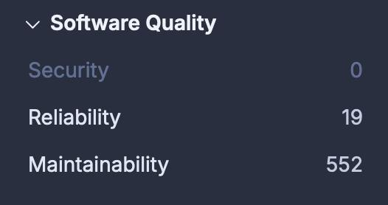
SonarCloud Analysis
The SonarCloud report identified 571 issues:
High-severity (160) mainly involve cognitive complexity, making certain functions hard to understand and modify.
Medium-severity (169) include improper logging practices and redundancy.
Low-severity (242) address deprecated functions, redundant casts, and unresolved TODO comments.
Efforts were focused on selectively addressing cognitive complexity to minimize the risk of introducing new bugs during refactoring.
Notes:
Some medium- and low-severity issues were also resolved, progressively improving the overall code quality.

Slide 6
Dockerization
FileDaemon Class:
Simulates a Daemon process to test application functionality by writing data to an Output.txt file while a dedicated thread monitors changes and logs updates to a Log.txt file. A 5-second cooldown is implemented to prevent excessive logging and ensure system stability.
The thread logs all file modifications with timestamps, aiding in the debugging and testing processes.
Notes:
Docker is used for automating the deployment, scaling, and management of applications via lightweight containers.

Slide 7
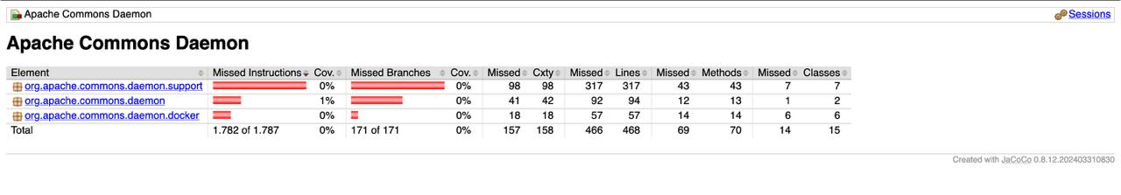
JaCoCo
JaCoCo was used to measure code coverage and generate detailed reports.
This limited coverage was attributed to the project's reliance on native code (C/C++) and integration with external environments, which reduced the effectiveness of Java unit tests.
Notes:
Developers probably prioritized manual testing and system-level integration tests over implementing a comprehensive Java unit test suite.

Slide 8
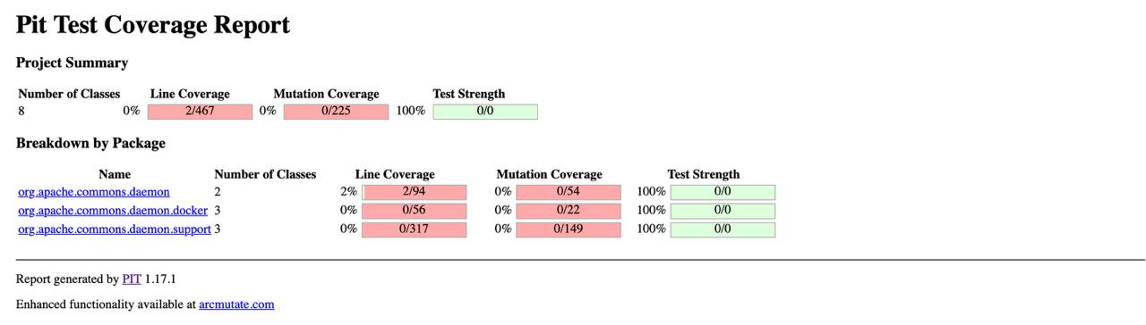


Pitest
The mutation coverage value is 0%, and the line coverage value is close at 2%, these percentages match the JaCoCo report.

Slide 9
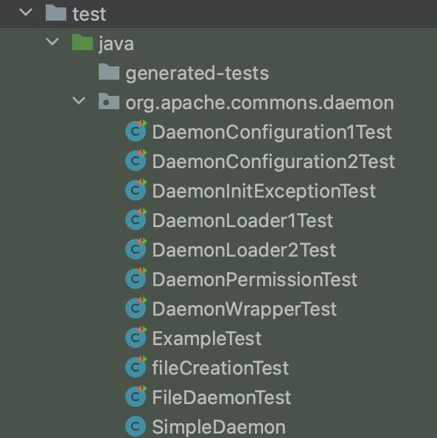
Randoop
Randoop was used to significantly increase the project's code coverage.
Compatibility issues arose with the JUnit version being used, particularly due to the use of the generic "assert" method.
Moreover, Randoop faced challenges in generating effective tests for the DaemonWrapper class, as the resulting tests were inconclusive.
Notes:
Output output limited to 1000 tests to reduce generation time.
These issues were resolved by replacing "assert" with more specific assertions like "assertNull" and "assertNotNull."

Slide 10
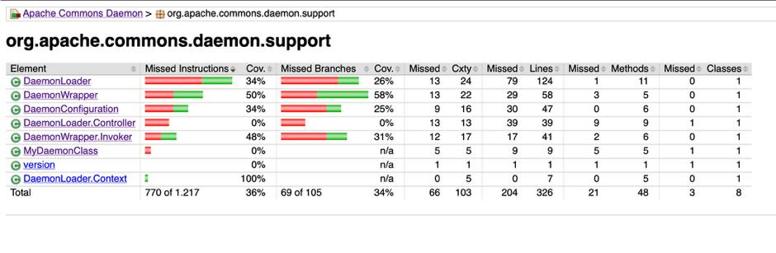
Github Copilot
GitHub Copilot was utilized to generate the test suite for the DaemonWrapper class due to multiple issues encountered with Randoop.
GitHub Copilot was also employed to create a test case for the load() method of the DaemonLoader class, as Randoop did not adequately test that method.
Notes:
The generated tests were specifically tailored for JUnit 5 to ensure compatibility.

Slide 11
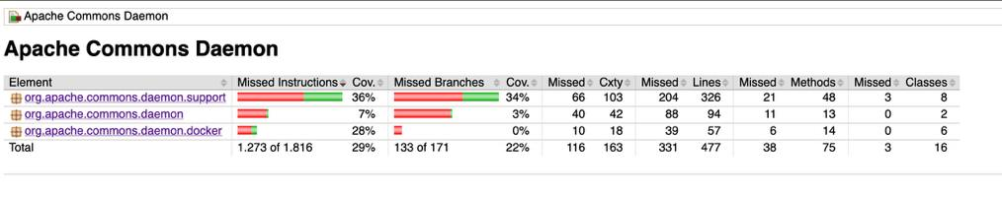
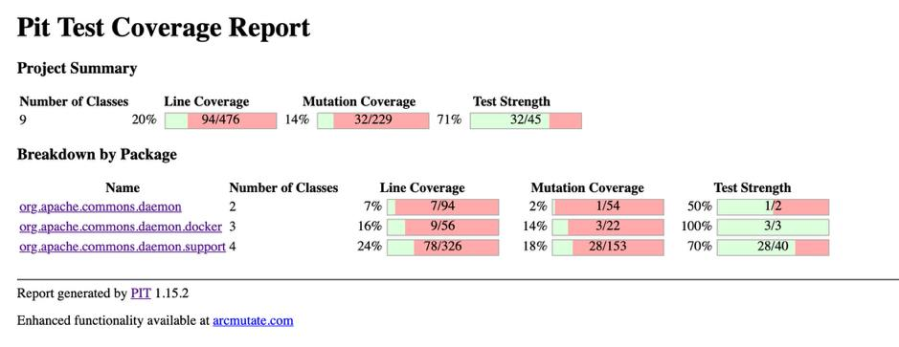
The updated JaCoCo report show significant improvement in test coverage for both the entire project and the "support" package, which contains the most Java classes.
The PIT Test Coverage Report also shows a significant improvement compared to the previous analysis. In the "support" package, mutation coverage increased to 18%, with a test strength of 70%.
Notes:
The PIT Test Coverage Report indicates 20% line coverage, 14% mutation coverage, and 71% test strength across the project

Slide 12
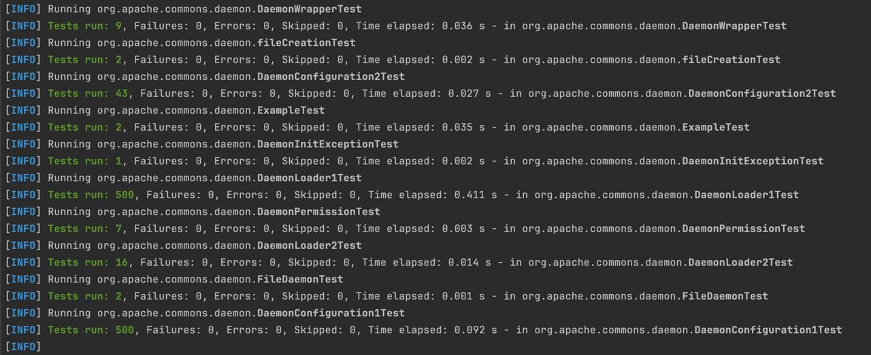
JMH
JMH (Java Microbenchmark Harness) was used to evaluate the performance of various functionalities in the project.
The benchmarks identified DaemonLoader1Test as the most time-consuming test, taking 0.411 seconds.

Slide 13

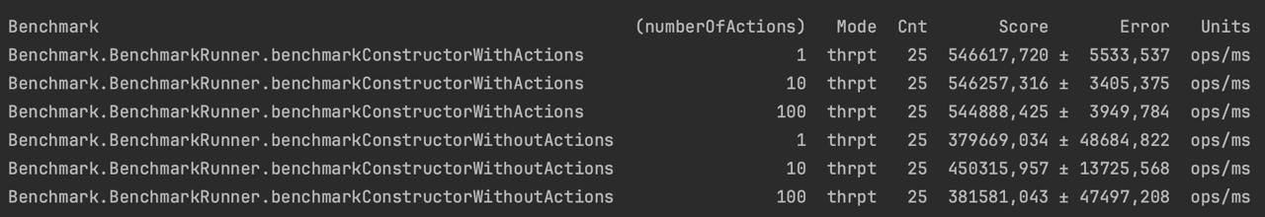
The benchmark compared two DaemonLoader constructors with varying inputs (1, 10, 100 actions).
The "With Actions" constructor showed stable and efficient performance, while the "Without Actions" constructor exhibited lower and more variable performance.

Slide 14
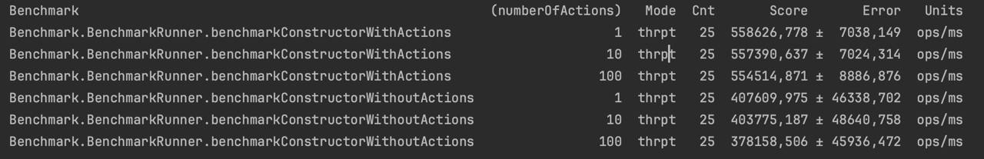


After optimizing the DaemonLoader class by improving logging and exception handling, the benchmarks were re-run.
The second set of benchmarks demonstrated higher throughput and better performance, indicating the effectiveness of the optimizations.

Slide 15
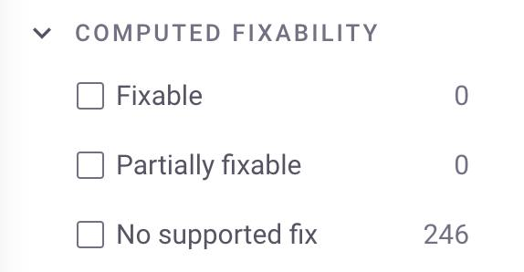
Snyk
Snyk's analysis of the project revealed that most security vulnerabilities were found in the Dockerfile, with no available fixes. As a result, the focus shifted to addressing vulnerabilities in the codebase.

Slide 16
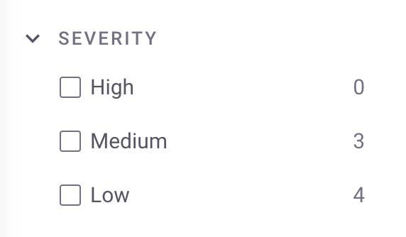
The code analysis identified seven medium or low-severity bugs.
Notably, only the Path Traversal issues were related to Java classes, while the other bugs stemmed from the C code.

Slide 17

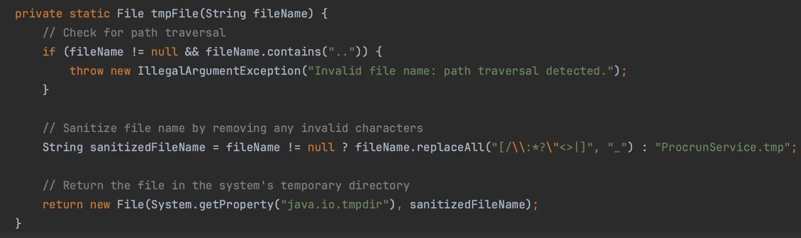

A Directory Traversal attack aims to access files and directories outside the intended folder. By exploiting "dot-dot-slash (../)" sequences or using absolute file paths, attackers can potentially access arbitrary files on the system, including application source code, configuration files, and other critical data.

Slide 18
OWASP DC
The initial OWASP DC report identified 12 vulnerable dependencies, each one with a CVE count between 0-5, raising suspicion of false positives.
Cross-checking with Snyk confirmed that some vulnerabilities were indeed false positives, while others were tied to older versions of dependencies with known issues.

Slide 19

Thank You for your Attention
Software Dependability Project
Gianluca Ronga

